Slide 1
GROUP B
Afolabi James
Ajeyomi Adedoyin
Alli Fesomade
Michael Ajiboye
Ifeanyichukwu Onyechere

Slide 2

OUR TASK
Project 2: Stock Market Data Streaming & Analysis
Stock prices for companies like TESLA (TSLA) and NVIDIA (NVDA) fluctuate rapidly. Your task is to build a real-time data pipeline that streams stock market data for these two companies using the Alpha Vantage API, processes the data to compute metrics like price changes, moving averages, and volume spikes, and stores the results in a queryable and structured format.
Select and justify a preferred tech stack.
Design and submit a high-level architecture diagram.
Break project into components and assign team members.
Share tools/resources to be used to execute the project.
Stores the results in an efficient format (partitioned by symbol/date/hour).

Slide 3
Task Breakdown
Research and Architecture Development (Cloud deployment)
Ajeyomi Adedoyin
Etl pipeline and Data Exploration
Ifeanyichukwu Onyechere
Analytics and alerting using slack
Alli Fesomade
Documentation and Fastapi endpoint
Michael Ajiboye
Slides and CI using Github Action
Afolabi James

Slide 4
Proposed Tools and Why
API Endpoint: The data source provides updates at 1-minute and 5-minute intervals; we opted for the 1-minute frequency to ensure near real-time data freshness and more granular insights.
S3: Stores raw and processed data; low cost, charged based on storage used and access requests.
Firehose: Streams data every minute to S3 or Redshift; billed by data volume and frequency, making 1-min intervals more costly but necessary for real-time precision.
Python with Boto3: Pulls data every minute from the API and sends it to Firehose; no direct cost, but downstream AWS usage incurs charges.
Lambda: Transforms the 1-min interval data in Firehose before storage in S3; cost-efficient for small, frequent payloads due to per-invocation pricing.

Slide 5
Proposed Tools and Why
Athena: To query data from the s3 bucket.
Github Action: For continuous integration with cloud resources
FastAPI: API endpoint connected to out RDMS to get clean data and analytics

Slide 6
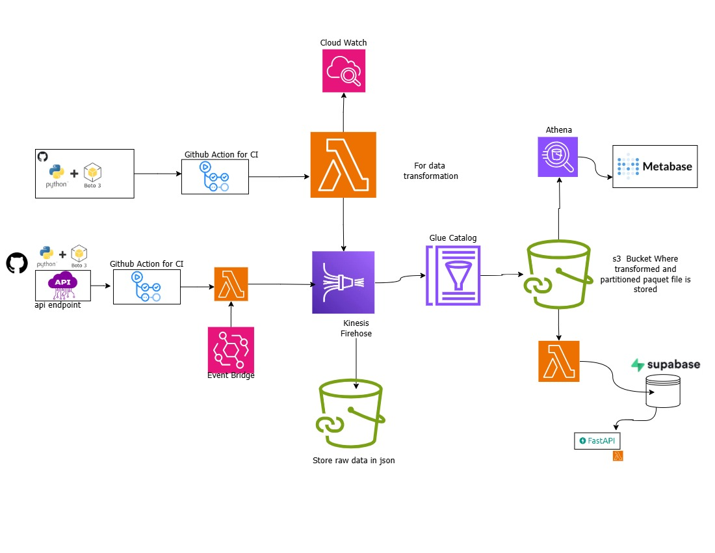
Proposed Architecture

Slide 7
Redshift: Performs analytics on streamed data; higher cost, best suited for heavy aggregations and dashboards—optimize usage or batch loads to control spend.
Slack: For alerting and reporting update on pipeline
Github Action: For continuous integration with cloud resources
FastAPI: API endpoint connected to out RDMS to get clean data and analytics

Slide 8
Chanlleges and Limitation
Lack of active participation from a team member: One of the major challenges was that a team member was not active and did not contribute to the task they were assigned. This limited the team's overall progress. With full participation from everyone, we could have achieved more and reached a higher level of completion.
Skill gaps in cloud computing: Another limitation was the presence of team members with little or no knowledge of cloud technologies or basic technical concepts. Although this posed a challenge, it did not stop the team from working collaboratively and ensuring that tasks were completed through support and shared learning.

Slide 9
AWS Services Weekly Cost Estimate
AWS Service | Cost per Week (USD)
AWS Lambda | $0.01
Amazon Kinesis Firehose | $0.03
Amazon S3 (Standard Storage) | $0.03
Amazon Anthena (5gb per week) | $0.02 per
Supebase Postgres | $0
Total Estimated Weekly Cost | $0.08
Assumptions:
API invocation frequency: Every 1 minute
AWS Lambda execution: 128 MB memory, 200 ms per call,
Weekly API Calls: 10,080 (1 call/minute × 7 days)
Kinesis Firehose Data ingestion: 100KB per API call (~0.96GB/week)
S3 Storage: Approximately 5GB
Amazon Athena Charges 5$ per TB

Slide 10
Thank you Suggestion from Mentor

